Slide 1
Conference of Radiation Control Program Directors, Inc.
United States Department of Transportation Special Permit (DOT-SP)
Guidance and Best Practices for:
DOT-SP 10656 & DOT-SP 11406 Forms Revised in 2023

Slide 2
The DOT-SP form is broken into 6 sections. This document is intended to provide additional instructions and guidance to facilities and radiation control officials during the issuance of DOT-SP authorizations. Details provided in this document focus on items that have been historically challenging or not intuitive. Therefore, not all fields are defined and/or explained. Should a conflict arise between the DOT Special Permit document and this guidance document the DOT-SP takes priority.
Scope and Purpose

Slide 3
Definitions
Approval Number: The unique identification assigned to a conveyance for transportation.
Carrier: The company or persons providing transportation of the load.
Destination Facility: The facility that will receive the shipment from the detection facility via the DOT-SP, which may be the same as the Shipment Origin.
Destination State: The State within which the destination facility is located and will receive the load after detection of material and the issuance of the DOT-SP, which may be the same as the Detection State.
Detection Facility: The facility at which the unknown material was found to be radioactive; the alarming facility.
Detection State: The State with the detection facility that is responsible for receiving detection information and issuing the DOT-SP.
Origin State: The State from which the load of material originated before detection.
Positive Contact:. Positive contact means that the sender receives a personal acknowledgment from the receiver.
Shipment Origin: The facility from where the unknown material originated before detection.
Special Permit: The approval from the USDOT to the CRCPD to authorize transportation under SP 10656 or SP 11406.
Transit State: The State or States through which the carrier will transport the load after the issuance of the DOT-SP.
Unidentified & Unexpected Radioactive Material: These are radioactive or radioactively contaminated materials that were not known to be present in the conveyance until after transportation began.

Slide 4
Acronyms
CRCPD - Conference of Radiation Control Program Directors
mrem/hr - Millirem per hour
OHMSPA - Office of Hazardous Material Special Permits and Approvals
PHMSA - Pipeline and Hazardous Materials Safety Administration
SP - Special Permit
USDOT or DOT - United States Department of Transportation
µrem/hr - Microrem per hour

Slide 5
When Is a DOT-SP Issuance Needed
The DOT-SP authorizes the one-way transportation of shipments in commerce by highway or rail that are found to have unexpected and unidentified radioactive material or contamination. The DOT-SP allows the shipment to be transported to a location better suited for characterization and/or disposition as determined by the authorizing State official.
Unexpected and Unidentified radioactive materials are radioactive or radioactively contaminated materials that were not known to be present in the conveyance until after transportation began.
DOT-SP 10656 (Scrap Metal)
DOT-SP 11406 (Liquid or Solid Waste)

Slide 6
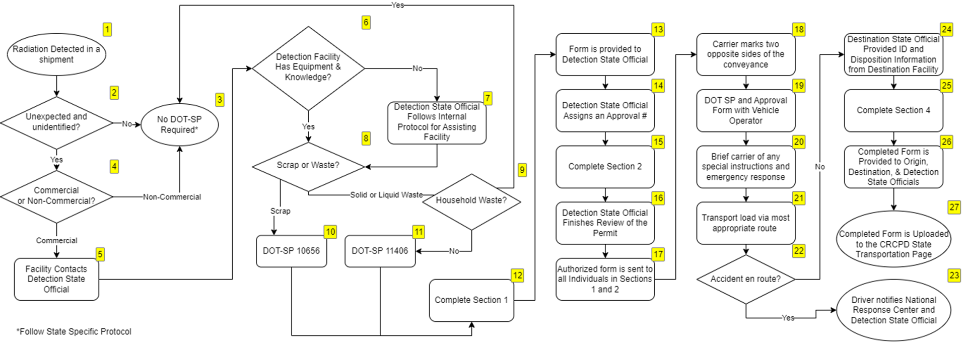
DOT-SP Process Overview

Slide 7
Section 1 - Details of Detection Site, Materials, Origin, and Destination
Process Details
Determine if SP 10656 (Scrap) or 11406 (Solid or Liquid) is needed
Complete each sub-section, ensuring at least one mode of contact (email or fax) is available for approval transmission.
If being completed by Detection Facility, provide form to Radiation Control Official for authorization. Transportation – CRCPD Authorized Users-Special Permits SP 10656, SP11406.
Detection Facility or;
Detection State Official if Facility is unable or ill equipped.
Section Completed by:
Information is generally collected by the Detection Facility

Slide 8
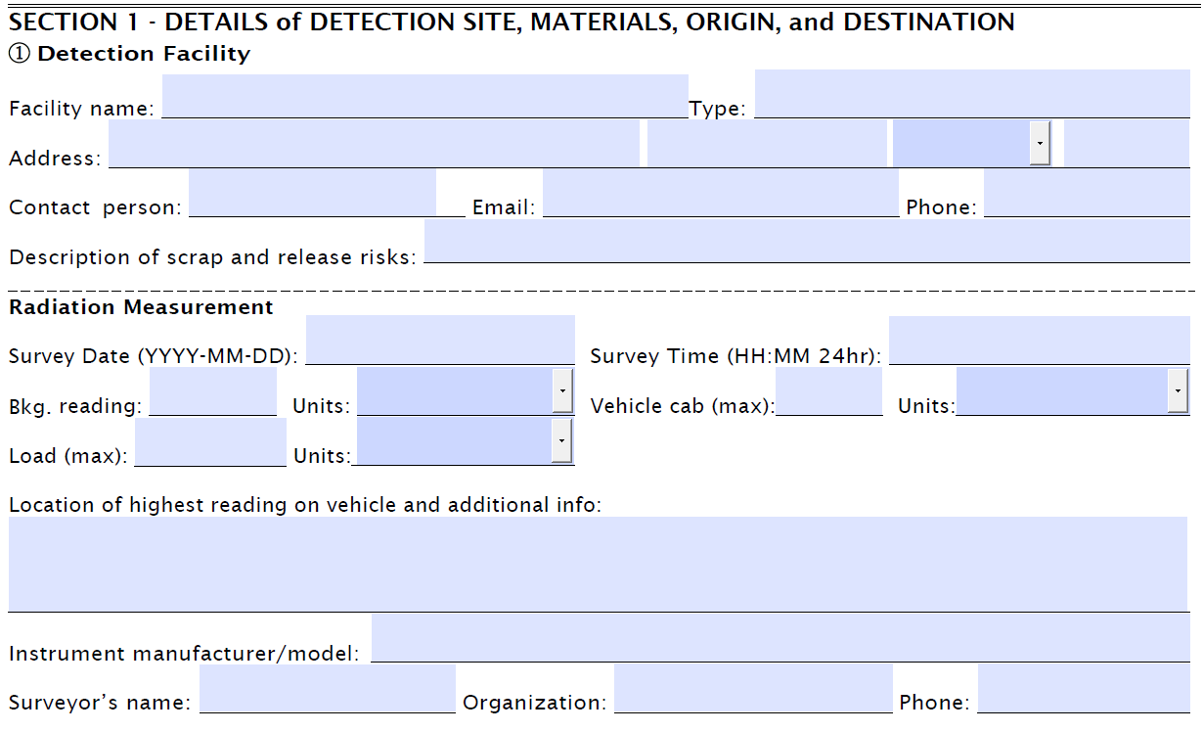
Detection Facility and Measurement Information
At least one mode of contact is required (email or phone).
Should email not be available a fax number can be entered in the email field. (Phone # still required)
Radiation measurements must be reported in the units provided (mrem/hr or µrem/hr)
Vehicle Cab (max): Cannot exceed 2 mrem/h, applies to any occupied space
Load (max): Cannot exceed 50 mrem/h. If exceeded, follow State specific response protocol. A DOT-SP cannot be issued.
1R=1rem=1rad approximation is appropriate
Should available equipment only read in counts per second (CPS) or counts per minute (CPM) the Detection State Official should assist in providing a reasonable conversion to mrem/h.
When conversions and approximations are used for unit conversion an explanation shall be provided in Section 5 – Remarks, Other Information

Slide 9
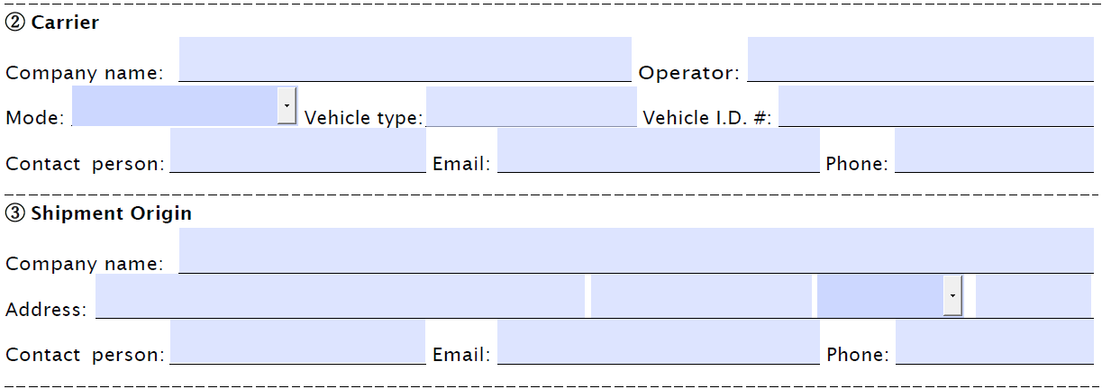
Carrier Information Detail
Operator: Driver or person directly responsible for conveyance
Vehicle Type: Brief description of the type of vehicle (dump, tandem, flatbed, Gondola, etc.)
Vehicle ID #: Any unique identifying ID (DOT #, License Plate, Company Vehicle ID). When the vehicle can be separated from the container, additional ID information for the container is desirable.
Contact Person: This can be the operator, but could be an alternate person supporting the carrier operations

Slide 10
Section 2 – Radiation Control Officials
Process Details
Issue a DOT-SP number.
Section Completed by:
Detection State Official
Identify Radiation Control Officials. Transportation – CRCPD Authorized Users-Special Permits SP 10656, SP11406.
Transit State Radiation Control Officials – Positive contact not required prior to authorization
Destination State Official – Positive contact required prior to authorization
Email is preferred, but fax can be used as a replacement for form transmittal.
If the Destination State Official is the same as the Detection State Official, then check the box next to ⑦. Details need not be completed.

Slide 11
Issue Approval Number
Enter Approval Number on Page 1 following format defined in 8a-8b
All other pages will auto-populate if using the pdf fillable form. Otherwise, each page will need this Approval Number
Example: AR-KY-99-004 would be the 4th Approval number detected in Arkansas, destined for Kentucky in 1999
Note: There may be duplicate Approval numbers since 10656 and 11406 are submitted in different sections of the CRCPD transportation page
Two Character Abbreviation for Detection State
Two Character Abbreviation Year of Detection
3 Digit Sequential Number
Two Character Abbreviation for Destination State

Slide 12
Section 3 – Approval of Shipment and Special Conditions
Process Details
Confirm contact information exists for each previous section of the permit.
Section Completed by:
Detection State Official
Ensure Destination Facility is aware of the return shipment, as carriers may not be affiliated. Facility should have a safe location to conduct investigation. Detection facility or carrier may confirm this information.
Review radiation numbers.
External surface of conveyance < 50 mrem/hr
Occupied space < 2 mrem/h
Provide any special conditions, like routing.
Review to ensure load is not dispersible and does not present any risk beyond the transport of the material within normal regulations.
Sign permit.
Date transmittal in Section 6 and distribute permit.
If the Detection State Official is the same as the Origin State Official, then check the box next to ⑧. Details need not be completed.
If the permit process is initiated, but not completed see special conditions section of this document.

Slide 13
Section 3 - Conveyance Markings
10.d. requires the conveyance to be marked with the Special Permit number (“DOT-SP 11406” or “DOT-SP 10656”) and “Radioactive” on two opposing sides of the conveyance for both rail and highway.
It is recommended the Approving Radiation Control Official provide markings compliant with this requirement and include it in the transmittal package upon completion of Section 3.
Templates that are compliant with the marking requirements are available on the CRCPD transportation page.
DOT-SP 10656 Form & Marking
DOT-SP 11406 Form & Marking

Slide 14
Transmittal of Shipment Approval
Enter date of transmittal.
Send the approved permit to all parties listed
Include the Shipment Approval and Special Permit
Markings can also be included if generated

Slide 15
Responsible parties
Process Detail
Detection Facility provides executed Shipment Approval and the Special Permit to vehicle operator. The permit shall be printed and carried by the Operator.
Marking shall be placed on two opposing sides of the conveyance.
Transit to Destination Facility via most appropriate route without unnecessary or avoidable delay.
Report any emergencies to the National Response Center (800-424-8802) and the Radiation Control Official authorizing the shipment.
Detection Facility
Carrier
Permit Use & Transit

Slide 16
Section 4 – Identification and Disposition Information at Destination
Process Details
Work with Destination Facility to identify source of radioactivity, per agency protocol.
Section Completed by:
Disposition State Official, often the same as Destination State Official. If so, check the box next to ⑨. Details need not be completed.
See Special Conditions Section of this document for guidance on closing permits without identification and disposition details.
Information provided by Destination Facility.
Assist in determining appropriate disposition if appropriate.
Complete Section 4.
Identification: enter any description of the material
Radionuclide: specific radionuclide, not just “NORM”
Disposition: enter intended disposal pathway (could be store in place)
Enter date in Section 6 and complete transmittals.

Slide 17
Transmittal of ID and Disposition
Enter date of transmittal.
Send the updated permit with ID information
Enter date of submission to CRCPD
See next page for detailed instructions

Slide 18
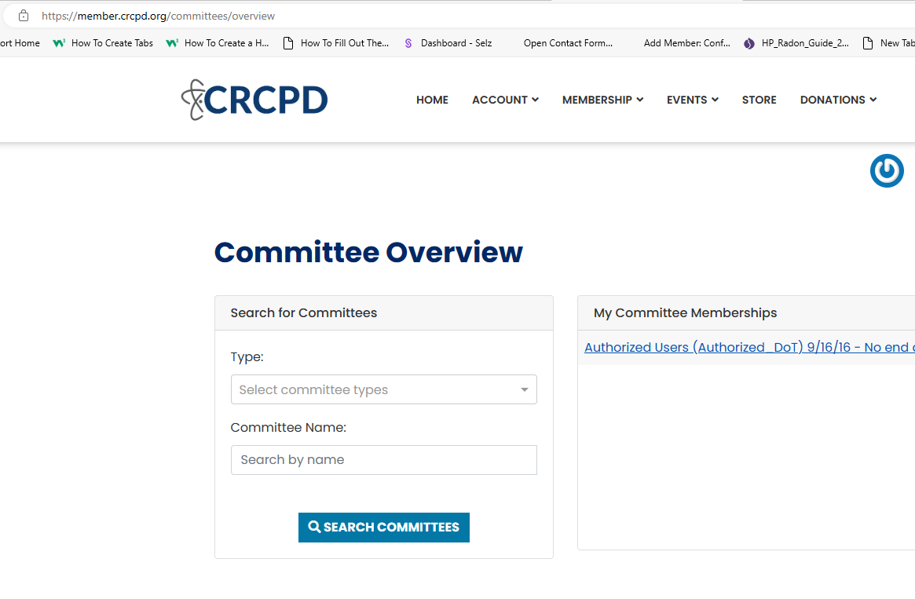
Transmittal to CRCPD Transportation Page Instructions
Enter your email address, create a password, then enter your first and last name. While your old log in information was not migrated to the new site, all of your other data was. The system should recognize you and attach your new username and password to your existing data.
Once you’ve logged into your profile, select ‘Membership” and click on “Boards & Committees”
Click on “Authorized Users..” under My Committee Memberships

Slide 19
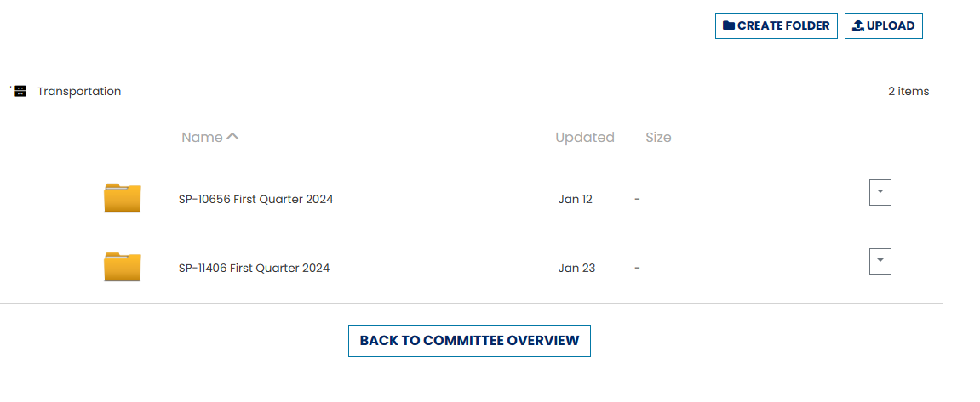
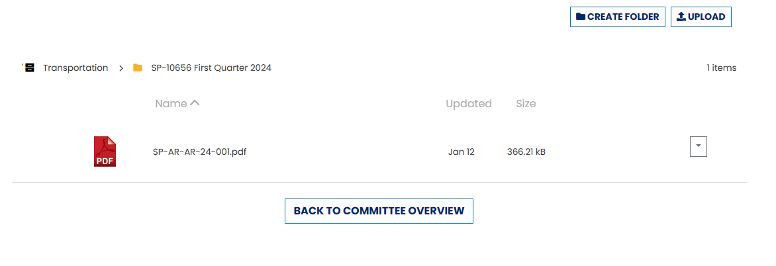
Transmittal to CRCPD Transportation Page Instructions
At the bottom of the Committee page is the Transportation File cabinet. There are currently first quarter folders for SP-10656 and SP 11406. I will create fresh folders each quarter. (This will help us greatly with our new reporting requirements)

Slide 20
DOT-SPs Initiated, Not Completed
Facilities may contact Radiation Control Officials and request a DOT-SP, which does not get fully executed (signature in Section 3).
An example of this condition is a drive-off.
Process Details
Complete as much of Section 1 as possible.
Issue an Approval Number per usual.
Attempt to reach the transportation company to inform them about the DOT-SP process. Note any communication in Section 5. Include any pertinent information, such as repeat offender, blatant refusal to comply, etc.
Fill out Section 3 and check the box below the signature field. This will prevent an authorization signature.
Submit the DOT-SP form to the OED CRCPD through normal transmittal methods explained in section 4. Do not directly send to the DOT.
CRCPD OED will transmit a summary of these events on a quarterly basis to the DOT.
Should Radiation Control Officials have significant concerns about the load, internal agency-specific protocols should be followed.

Slide 21
Permits Without Identification and/or Disposition
It is the responsibility of the Destination State Organization to complete the transmittal of the DOT SP form. Destination facilities should provide information for Section 4 of the DOT-SP. Should Radiation Control Officials not be able to complete identification and disposition for a specific permit, per their agency requirements, then the following process should be followed.
Make notes in Section 5 about efforts made.
Enter Radiation Control Official information in Section 4. Other fields will not be completed.
Submit the form to the OED CRCPD via standard transmittal methods.

Slide 22
Requesting Changes to Agency Authorized Users
Radiation control Program Directors can add or remove Authorized Users from the CRCPD list using this template. Changes to the Authorized Users list should be emailed to: bhirschler@crcpd.org
Authorized Users are individuals trained and certified by Program Directors. This document should be used as a training aide.

Slide 23
Special Provisions Guidance
Additional requirements for State Radioactive Materials Control Officials are under 8.c.
The following items are recommended for transmittal to managers of facilities with radiation monitoring systems.
This Guidance Document.
Methodology for contacting appropriate officials during normal business hours.
Methodology for contacting appropriate officials during non-standard business hours (24-hour reporting).
Indicate if the Radiation Control program requests the detection facility provide a populated approval form.
A link to the CRCPD transportation page: https://www.crcpd.org/page/Transportation (accessed 12/2023), which is where the most current DOT-SP forms reside

Slide 24
Helpful Links
Title 49 of the Code of Federal Regulations, Parts 100-185
https://www.ecfr.gov/current/title-49/subtitle-B/chapter-I (accessed 12/2023)
CRCPD Transportation Page
https://crcpd.org/transportation
DOT-SP 11406 Letter of Interpretation Ref. No. 04-0197
https://www.phmsa.dot.gov/regulations/title49/interp/04-0197 (accessed 12/2023)
CRCPD DOT-SP Authorized User List
https://crcpd.org/transportation “CRCPD Authorized Users-Special Permits SP 10656, SP 11406
DOT-SP 10656 Form and Marking
https://crcpd.org/wp-content/uploads/2023/11/DOT-SP-10656-Revision-2023-002.pdf
DOT-SP 11406 Form and Marking
https://crcpd.org/wp-content/uploads/2023/11/DOT-SP-11406-Revision-2023-1.pdf

