Slide 1


WEBINAR
Strategies for Supporting the Adoption of Radon-Reducing Building Codes
January 28, 2026
2:00 p.m. (Eastern)
Notes:
Kim

Slide 2
WELCOME
Logistics:
This webinar is being recorded.
All attendees are muted.
Please add questions to chat.
Target Audience: State and Tribal Radon Programs
Webinar Goal: The goal of this webinar is to increase state and tribal radon programs' knowledge and understanding of radon-reducing new construction techniques and the International Residential Code/Appendix F/AF/BE - "Radon Control Methods in New Construction". Ideas and examples will be shared for conducting outreach and education to code officials to support the adoption of radon building codes. Attendees will be provided with resources to support this effort.
Notes:
Kim

Slide 3
AGENDA/SPEAKERS
2:00 – 2:05 Welcome, Introductions, Overview of the Agenda (Lisa Bruedigan, CRCPD)
2:05 – 2:15 RRNC Role in Radon Risk Reduction (Tommy Bowles, EPA)
2:15 – 2:25 Overview of Radon-Resistant New Construction Techniques (Joshua Kerber, MN)
2:25 – 2:35 Overview of IRC Appendix BE (Jane Malone, IEA)
2:35 – 2:40 Current Status in the U.S. for Code Adoptions (Jane Malone, IEA)
2:40 – 3:04 Examples of State Radon Program Efforts
2:40 – 2:48 Kansas: Building Relationships with Code Officials (Mark Ungerer, KS)
2:48 – 2:56 North Carolina: Working with the North Carolina Building Code Council (Phillip Gibson, NC)
2:56 – 3:04 Minnesota: Partnering for Better Radon Risk Reduction (Joshua Kerber, MN)
3:04 – 3:12 Code Official’s Perspective (Don Sivigny, MN)
3:12 – 3:20 CRCPD Resources and Tools to Support Adoption (Joshua Kerber, MN)
3:20 – 3:30 Questions & Answers (Please add your questions to CHAT)
Notes:
Speakers:
Joshua Kerber, M.S., Research Scientist, Indoor Air Unit, Minnesota Department of Health
Thomas Bowles, Indoor Environments Division, U.S. Environmental Protection Agency
Jane Malone, National Policy Director, Indoor Environments Association
Mark Ungerer, Health Physicist Supervisor, Kansas Department of Health and Environment
Phillip Gibson, Radon Program Coordinator, North Carolina Department of Health and Human Services
Don Sivigny, Supervisor of Education, Rules, Codes & Grants Programs; Minnesota Department of Labor and Industry

Slide 4
The Role of RRNC in Radon Risk Reduction – Tommy Bowles
Notes:
EPA perspective about how RRNC fits into radon risk reduction (i.e., houses continue to be built, so if they are not built with RRNC, then we are adding to the total stock of housing without the protections from radon included, etc.).

Slide 5
Overview of Radon-Resistant New Construction Techniques – Josh Kerber
Notes:
What is RRNC and why is it important for radon risk reduction (Josh technical big picture

Slide 6
Radon Resistant New Construction (RRNC)

Slide 7
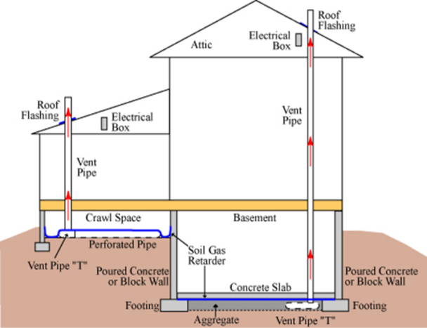
New Homes Must be Built “Radon Resistant”
RRNC codes and standards are very similar
Two Types of Approaches:
Passive
No fan
~40% reduction
Active
Radon fan
90+% reduction

Slide 8
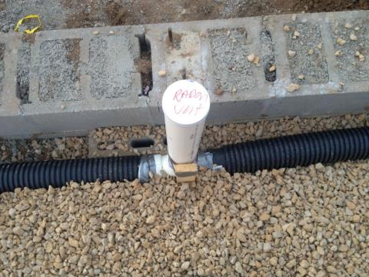
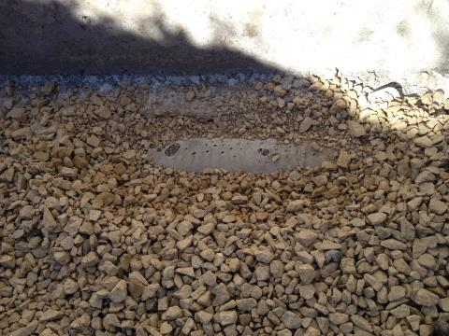
Aggregate Under the Slab

Slide 9
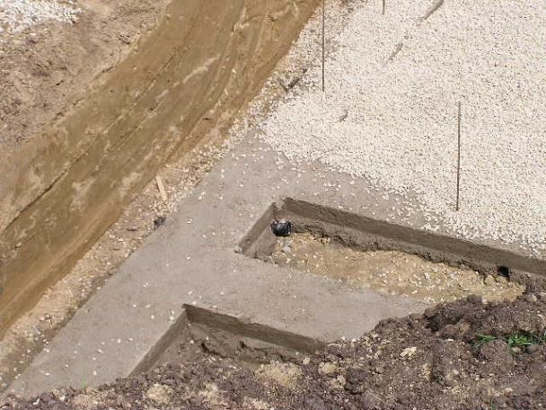
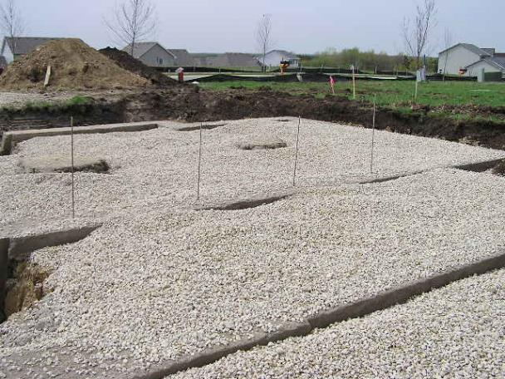
Gravel Layer and Footing Sleeves

Slide 10
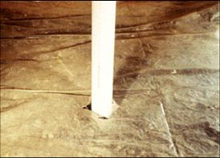
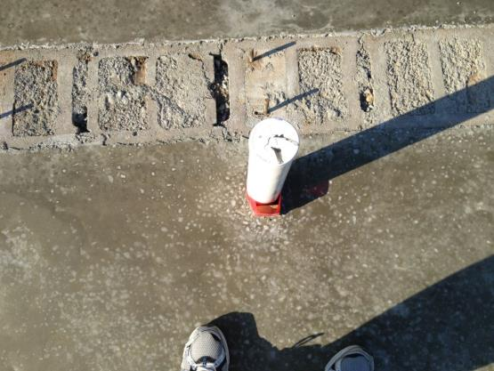
Vent Pipe and Soil Gas Retarder

Slide 11
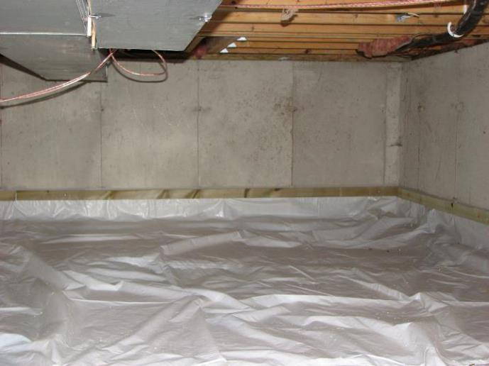
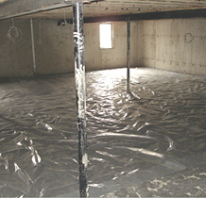
Membranes

Slide 12
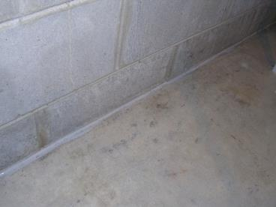
Sealed Cold Joint and Other Openings

Slide 13
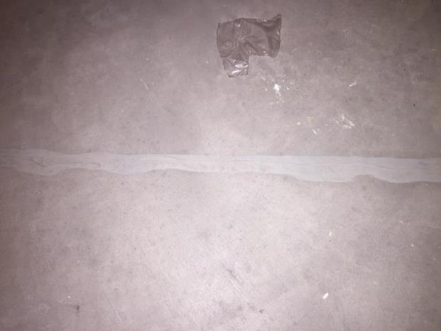
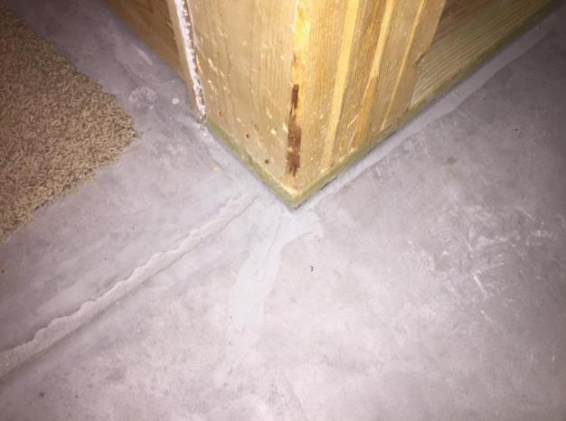
Sealing Floor Cracks

Slide 14
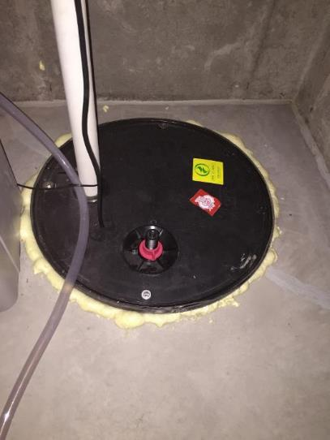
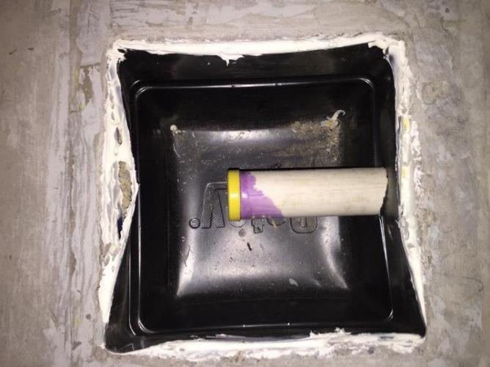
Sump and Plumbing Knock Out

Slide 15
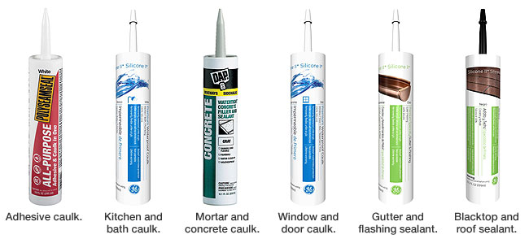
Sealants

Slide 16
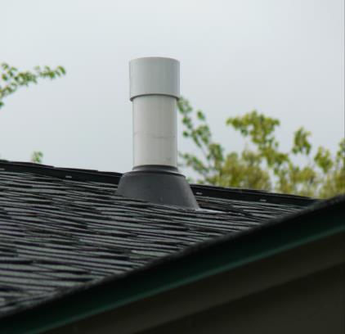
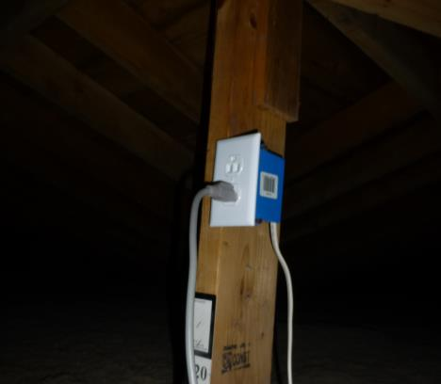
Roof Flashing & Electrical Junction Box

Slide 17
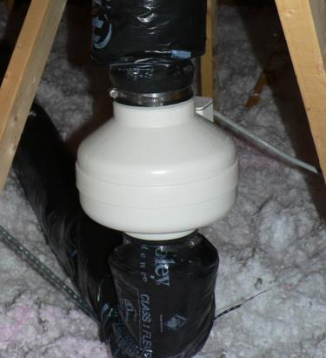
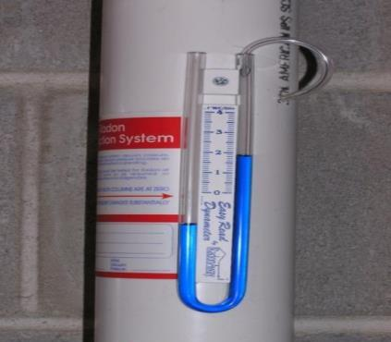
What’s Next?
1) Add fan during construction, or
2) Test for radon after occupancy--If elevated, activate the system

Slide 18
Why Activate Passive Systems During Construction?
Much lower radon level
Addressing false sense of security
Decreased liability by builders
Very cost effective
$200-$300 increased cost during construction
~$1 per month to run an active system

Slide 19
Homes with Passive Systems
806 homes tested
162 homes over 4 pCi/L (20%)
~40% existing MN homes over 4 pCi/L
1.9 pCi/L – average
3.1 pCi/L – average in all housing in these counties
38.2 pCi/L – highest result

Slide 20
Homes with Fans Added by Homeowner
72 homes activated
70 homes under 4pCi/L
Two homes over 4.0 pCi/L
Sealing details ignored
Once sealed, radon was greatly reduced
0.3 pCi/L – average
94.2% – average reduction

Slide 21
What Building/Code officials Need to Know About Radon in New Dwellings
Most common mistakes by builders
Overlooked details
No sealing of cracks and joints – most important
No room to add a fan in attic
No suction pit or connection to gas-permeable layer
Little to No radon testing being conducted
False sense of security for owner/occupant
All new homes need to be tested

Slide 22

Overview of IRC Appendix BE/AF/F
Current Status of Radon Control Adoptions
Jane Malone
National Policy Director
Indoor Environments Association
Notes:
Versions, new changes, testing requirement, inclusion of the ANSI/AARST RRNC as an alternate option

Slide 23
International Code Council
The ICC maintains the model codes:
International Residential Code (IRC): 1- and 2-family dwellings/ townhomes – home of the radon appendix
International Building Code (IBC) – non-residential, larger residential
Mechanical (IMC), Plumbing (IPC), etc. – “Family of Codes”
Each model code is updated every three years
ICC manages the code development committees and hearings
Final decision is made by voting ICC members – code officials
Open participation and stakeholder balance: limited

Slide 24
International Code Council and Appendix F
Appendix F, like other code appendices, is optional
“The provisions contained in this appendix are not mandatory unless specifically referenced in the adopting ordinance”
Proactive AHJ decision is needed
Advocates have tried to move radon into the body of the code
No success yet, or on the horizon

Slide 25
Appendix F Radon Control Methods - Contents
Subfloor preparation – aggregate or sand with geotextile matting
Soil-gas retarder below slab
Entry routes, floor openings, concrete joints, foundation sealed
For crawl spaces: ventilation, soil-gas retarder on top of the soil
Vent pipe carrying radon from under the slab / crawl space membrane to above the roof
Vent pipe labeled, accessible in the attic
Power source for fan in the attic

Slide 26
Appendix F Radon Control Methods - Evolution
Developed 1993-1995 by code officials, EPA, builders
Unchanged until 2021 code when testing requirement was added
Minor change in 2024 code (to allow option for certain soils)
Four changes in 2028 code:
Radon zone map and zone 1 county list – deleted
Option to follow ANSI-AARST RRNC – added
Cylindrical space to allow room for fan in attic – added
Horizontal pipe inserted on both sides of the tee fitting – added
Name Changes
2021 renamed Appendix AF
2024 renamed Appendix BE
Notes:
Radon Control in the construction codes = same as RRNC Radon Reducing New Construction
Credit to EPA NCHH ALA CRCPD and IEA

Slide 27
2021 IRC Δ: Testing Requirement Added
Testing shall be performed ..
After the dwelling passes its air tightness test / HVAC install complete
Areas w/ different HVAC systems shall be tested separately
Not less than 48 hours duration
Under closed house conditions
By a builder, design professional, or approved 3rd party
Using a commercially available test kit
By an approved 3rd party using a CRM
Results less than 4 pCi/L shall be provided to code official
Where test result is > 4 pCi/L:
fan shall be installed, system modified until less than 4 pCi/L

Slide 28
2028 IRC Δ: Option to use ANSI-AARST RRNC
Allows additional occupant protections:
Sealing of submembrane gas retarder, extension on foundation wall
Improved clearances from exhaust pipe to prevent radon entry
Added option for stay-in-place forms
Vent pipe material compliant with the plumbing code spec
More thorough labeling requirements
Offers clear approach to radon rough-in – but passive system only
Benefits from a consensus process consistent with ANSI
EPA-recommends it along with the other ANSI-AARST standards

Slide 29

2028 IRC Δ: Radon Zone Map / List Deleted
“Inclusion of this appendix by jurisdictions shall be determined through the use of locally available data or determination of Zone 1 designation in Figure AF101.1 and Table AF101.1”
Language steered code/elected officials not to protect Zones 2 & 3
EPA was the lead proponent in removing it
An appendix should advise how to do something, not where or where not t
No other appendix is place-based
Code / elected officials are now free to adopt Appendix BE
Alternative data from CDC, available on the Radon Report Card for each state, shows prevalence of radon test results > 4 pCi/L

Slide 30
Summary: IRC Versions and the Radon Appendix
IRC Edition | Testing Requirement | Zone Map Deleted; RRNC Alternative Allowed
1995-2018 (App. F) | NO | NO
2021 (App. AF) | YES | NO
2024 (App. BE) | YES | NO
2028 (App. BE?) | YES | YES

Slide 31
How States and Localities Adopt: Pathway Will Vary
State legislature enacts model code as law
Three states’ laws created mandate to develop policy
State legislation empowers state-level appointive body/council
Adopted Appendix F as written – 4 states
Amended Appendix F while adopting it – 2 states
Created its own radon control requirements - 1 state
Adopted obsolete ASTM E1465 standard –1 state
Localities are authorized to adopt codes by State legislation
Some can vary from state version (home rule)
Some may only adopt state version (Dillon rule – state pre-emption)
In some states, localities free to adopt w/o any approval

Slide 32
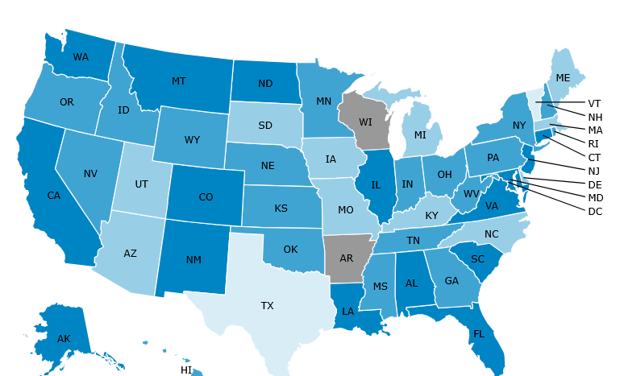
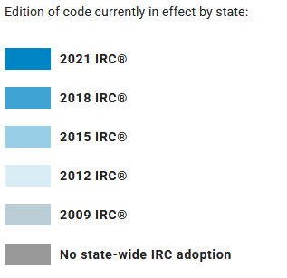
Residential Code Adoptions by Code Edition
Source: ICCSAFE.ORG

Slide 33
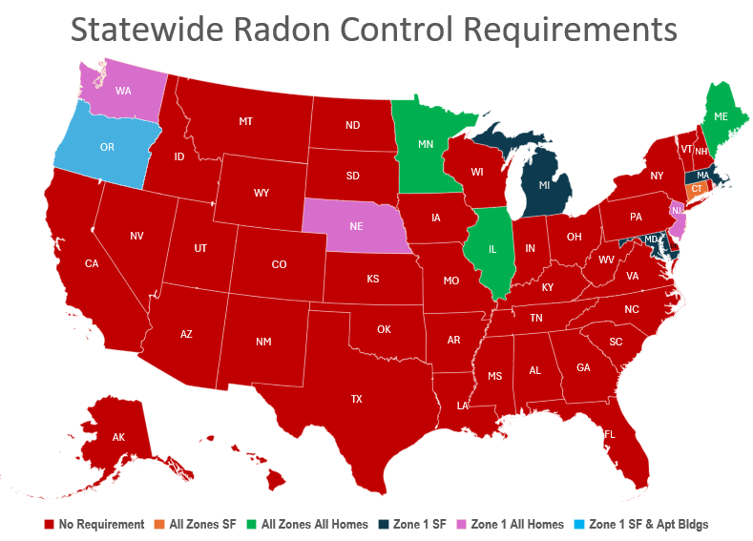


Slide 34
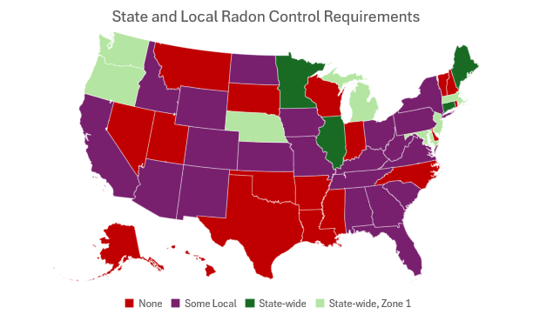


Slide 35
Summary: IRC Versions and the Radon Appendix
IRC Edition | Testing Requirement | Zone Map Deleted; RRNC Alternative Allowed
1995-2018 (App. F) | NO | NO
2021 (App. AF) | YES | NO
2024 (App. BE) | YES | NO
2028 (App. BE?) | YES | YES

Slide 36
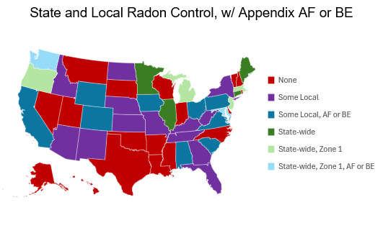


Slide 37

Tribal Resources on Codes
https://www.epa.gov/green-building-tools-tribes/codes-guidance

Slide 38
Statewide Radon Appendix Adoption: Considerations
Legislation may be needed
A legislatively appointive body may have the power to decide
Board or council, consisting of mostly code officials and some builders
Staff (state employees) may influence the decision-making
State staff may have the power without a board/council
State / regional building code officials association may play a role
If your state has adopted a statewide requirement, focus on
Getting the latest version adopted
Enforcement by local code officials: inspections, test results < 4 pCi/L

Slide 39
Local Radon Appendix Adoption: Considerations
Elected officials – such as city, county, or town council – decide
Not limited to Zone 1, suggestive language being removed in 2028
Code officials are extremely influential
Advise planning boards and elected leaders on feasibility, defensibility, merits
In many communities, code staff drive the decisions
Code officials sign off on permits, inspections, certificates of occupancy
Equipped with info, have opportunities for oversight
Connect with local code officials through
State and regional building code associations
County health departments
For localities that have adopted, focus on -
Getting the latest version adopted
Enforcement by local code officials: inspections, test results < 4 pCi/L

Slide 40
Examples of State Radon Program Efforts
Kansas: Building Relationships with Code Officials
(Jason Meinholdt, KS)
North Carolina: Working with the North Carolina Building
Code Council (Phillip Gibson, NC)
Minnesota: Partnering for Better Radon Risk Reduction
(Joshua Kerber, MN)
Notes:
Kim – introduce next segment

Slide 41

Kansas radon program
Kansas is a certification state. We certify measurement technicians, mitigation technicians, and radon measurement laboratories.
Building codes are adopted at the local level with some cities/counties having adopted RRNC and others have not. RRNC is exempted from radon certification requirements.
Kansas inspects radon mitigation systems on a tip/complaint basis with as-needed follow-up.
It’s become standard practice to have inspectors coordinate with local building officials during inspections to have them accompany us.
Outside of the radon aspect, in many smaller towns, the local official knows the community and can help build trust in you.
To protect and improve the health and environment of all Kansans

Slide 42
Inspections in locations where RRNC is adopted
When performing radon system inspections in areas where RRNC is required by code, coordinating with building officials is beneficial in many ways:
Sharing information about radon
Educating them about how radon mitigation systems work, both passive and active.
Teaching them to better understand what RRNC is, how the systems work, common issues seen in RRNC systems, and what to look for.
This allows us to act as an ambassador for radon awareness where the education we can provide can directly lead to risk reduction in an environment we aren’t normally included in.
To protect and improve the health and environment of all Kansans

Slide 43
Inspections in locations where RRNC is not adopted
When performing radon system inspections in areas where RRNC is not required:
We also share information about radon and talk about the importance of measurement and mitigation
We can educate a local “ambassador” for us, sharing radon awareness with the local community
Most importantly, they can be a voice to advocate for adoption of RRNC at the local level.
To protect and improve the health and environment of all Kansans

Slide 44

CRCPD: Strategies for Supporting the Adoption of Radon-Reducing Building Codes
NC DEPARTMENT OF HEALTH AND HUMAN SERVICES
Phillip Ray Gibson
NC Radon Program Coordinator
NC Licensed Real Estate Broker-in-Charge
January 28, 2026

Slide 45
Move radon-induced lung cancer from an emerging concern to a standing policy priority at the state and local level.
Integrate radon-related lung cancer risk reduction into state and local public health policies.

Slide 46




Slide 47
North Carolina General Assembly
North Carolina is a Dillon’s Rule state. That means local governments (counties and
municipalities) only have the authority that the General Assembly has granted them.
North Carolina Building Code Council
N.C. Gen. Stat. § 143-136 establishes the Building Code Council and directs it to adopt and maintain the State Building Code.
County Building Code Offices in NC
May not:
Adopt their own technical construction standards
Modify structural, electrical, plumbing, or mechanical requirements
Enact ordinances that conflict with or supplement the State Building Code
Regulate in areas the General Assembly has preempted

Slide 48
Efforts to Include AARST Standards into NC Building Codes
Empowered the NC Advisory Committee on Cancer Coordination and Control –
legislative and prevention subcommittees with knowledge of AARST standards
Conducted an online webinar supporting inclusion of AARST standards with speakers: Deputy Director of Duke Cancer Institute, Assistant Director of NC Cooperative Extension, Director of National Radon Program Services, President of AARST, National Policy Director of AARST
Letters of support from the latter list as well as from several other organizations on the NC Advisory Committee on Cancer Coordination and Control (Cancer Control Plan)
Presented on two separate occasions to the NC Building Code Council formally requesting. Rejected both times.

Slide 49
www.radon.ncdhhs.gov
Phillip.Gibson@dhhs.nc.gov 828-712-0972
Phillip Gibson

Slide 50
Partnering for Better Radon Risk Reduction

Slide 51
Partnerships
State Code Officials
Rule committee participation
Education coordination – Code officials, builders, and plumbers
Local Code Officials
Mitigation system inspection coordination
Training and Education
Onsite and online
Here’s an example of some of the materials

Slide 52
New Homes Must be Built “Radon Resistant”
Use previous slides and then go into everyday examples
Passive
No fan
~40% reduction
Active
Radon fan
90+% reduction

Slide 53
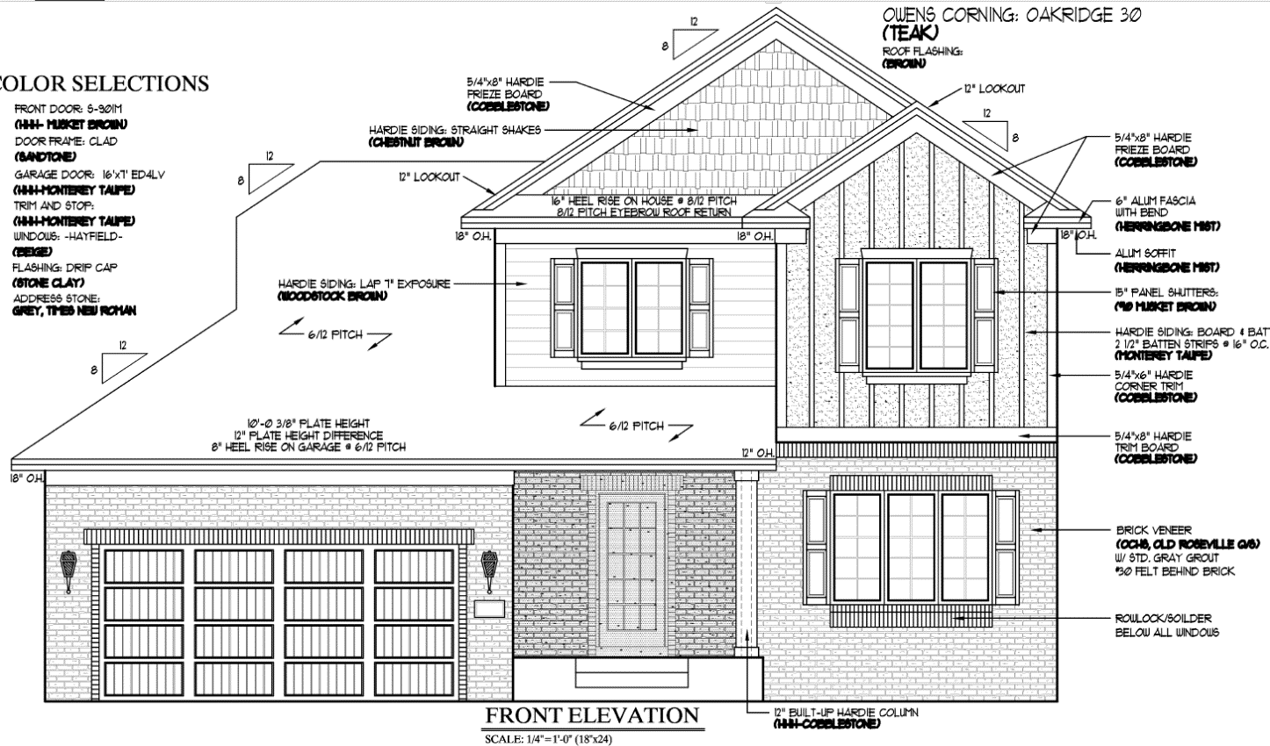
RRNC Case Study - Introduction to Patient

Slide 54
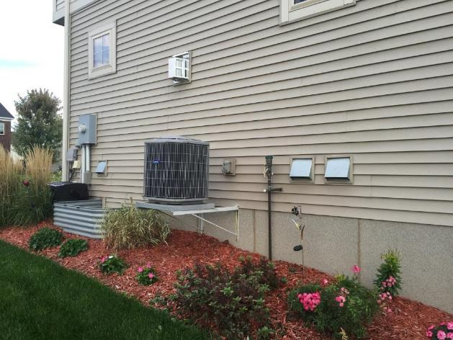
Intakes and Exhausts

Slide 55
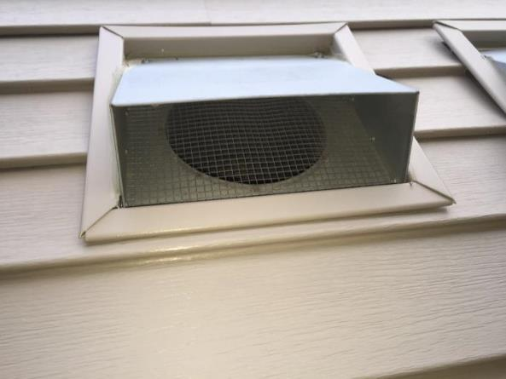
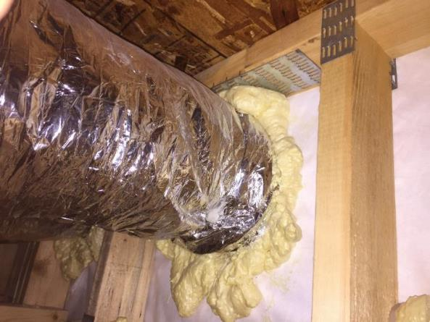
HRV & Fresh Air Intake

Slide 56
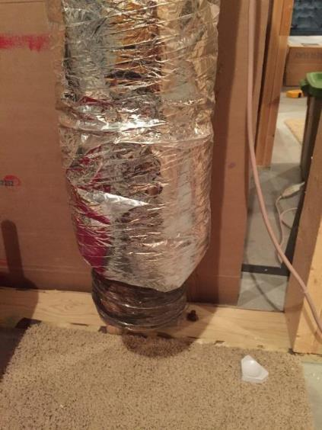
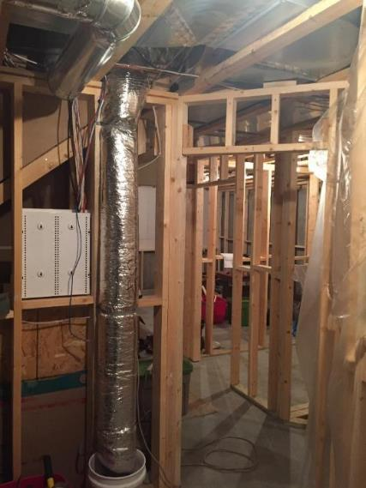
Fresh Combustion Air

Slide 57
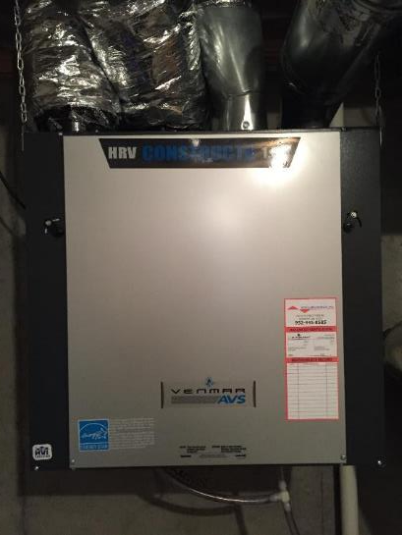
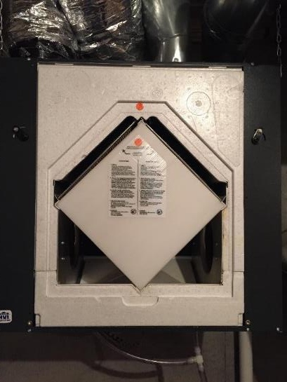
Air Exchanger

Slide 58
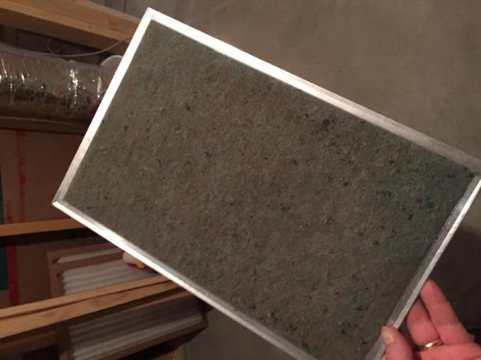
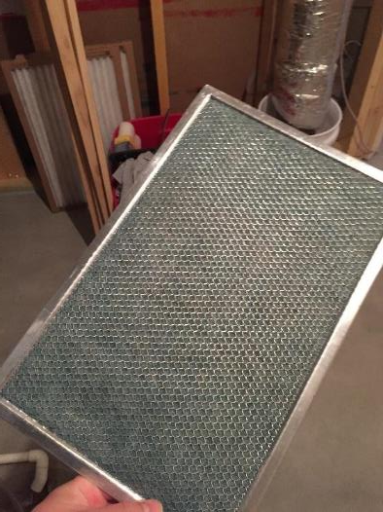
Air Exchanger Filters

Slide 59
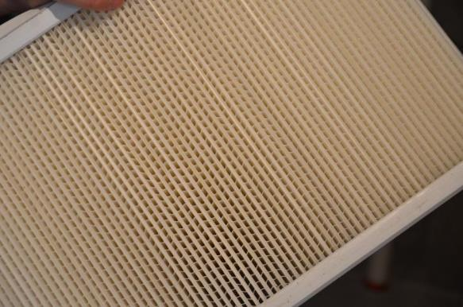
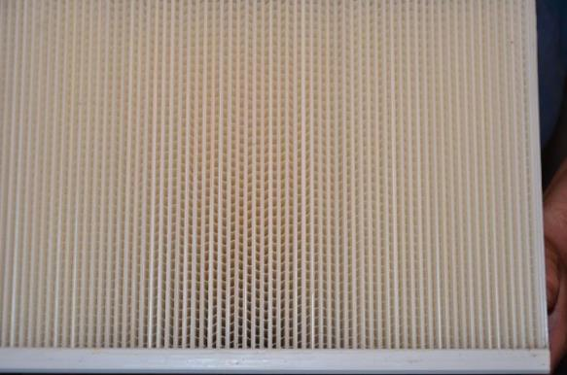
Air Exchanger Core

Slide 60
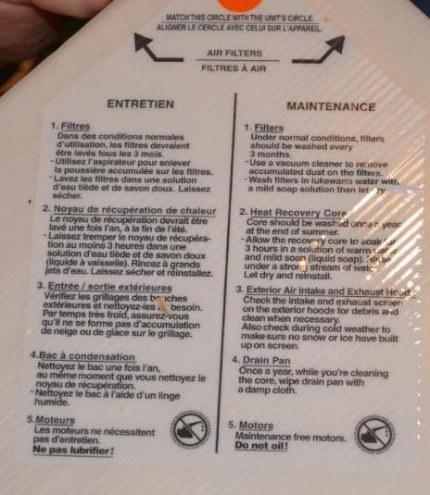
Maintenance
Maintenance Schedule
Filters
Quarterly
Core
Annually
Intake
As necessary
Also during cold weather
Drain pan
Annually

Slide 61
Effects of Air Exchanger
Does it effect radon levels?
Maybe, sometimes and it depends
If balanced or positively pressurized:
Dilution
Lessen negative pressure in basement
If unbalanced:
Send basement more negative

Slide 62
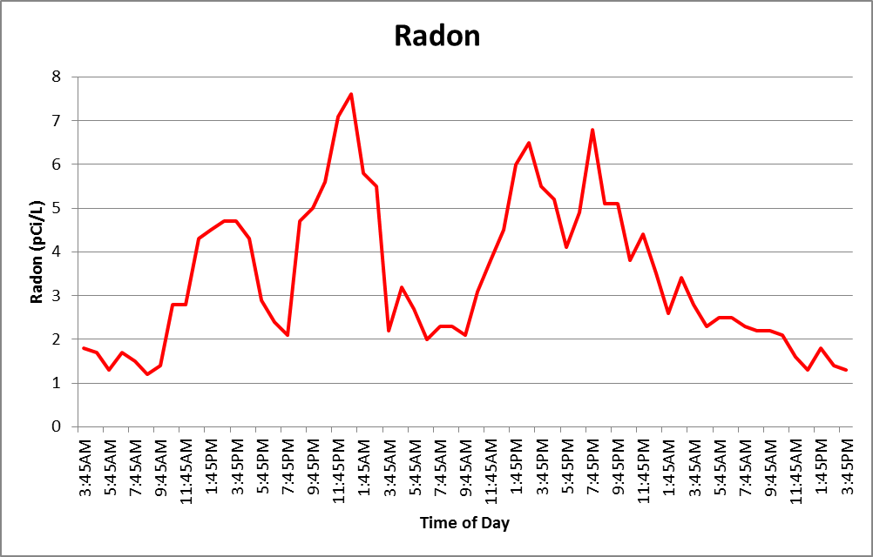
Is RRNC Working Here?

Slide 63
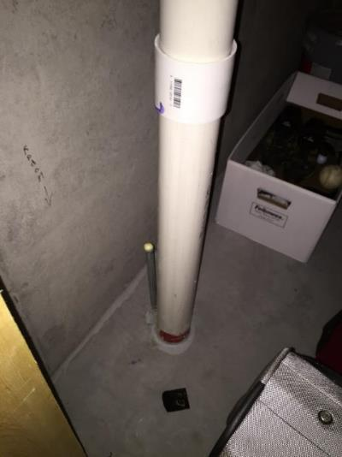
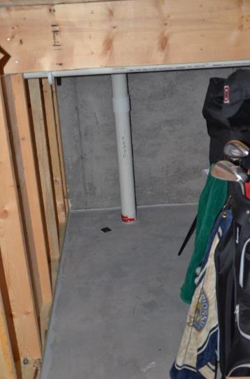
Suction Point

Slide 64
What are We Up Against?
Mother nature
House operation
Occupant usage
Construction details

Slide 65
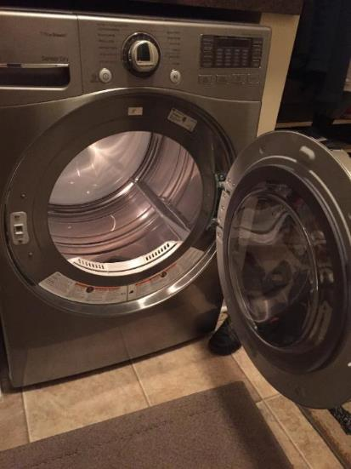
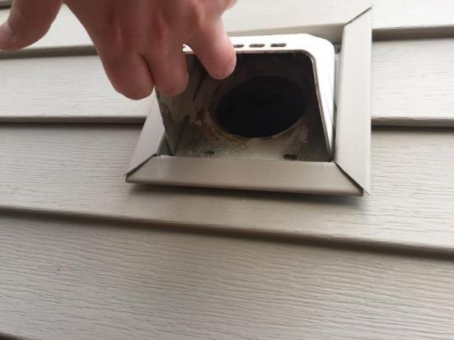
Dryer

Slide 66
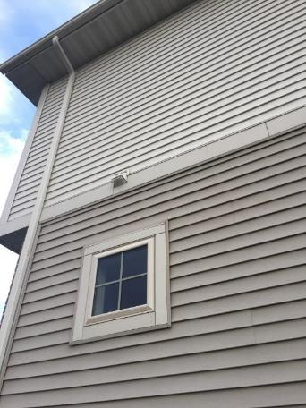
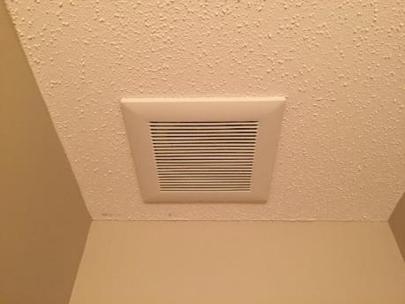
Bath Exhaust Fans x 3

Slide 67
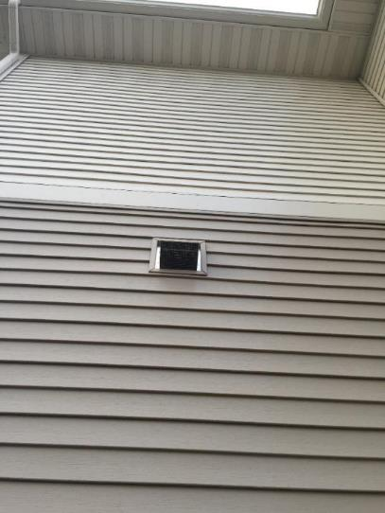
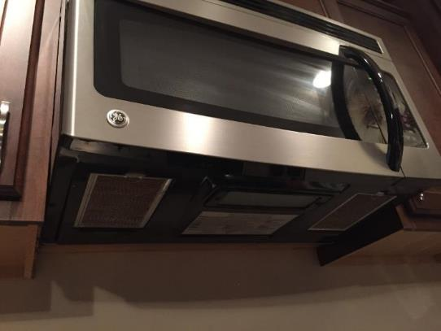
Kitchen Exhaust Hood

Slide 68
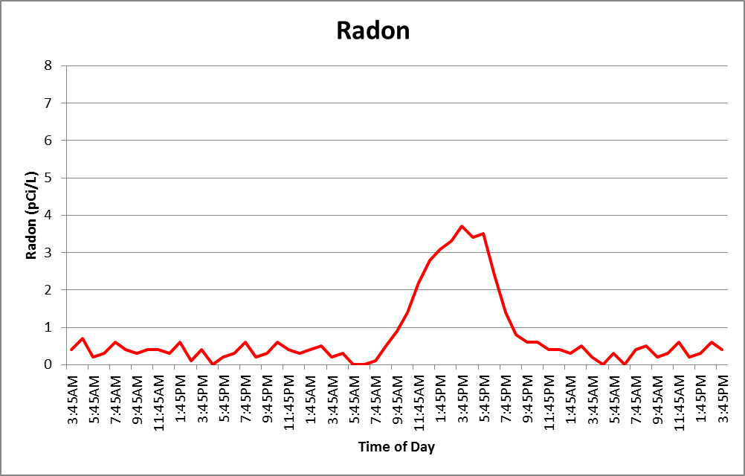
Radon Levels – After Sealing

Slide 69
System Activation

Slide 70
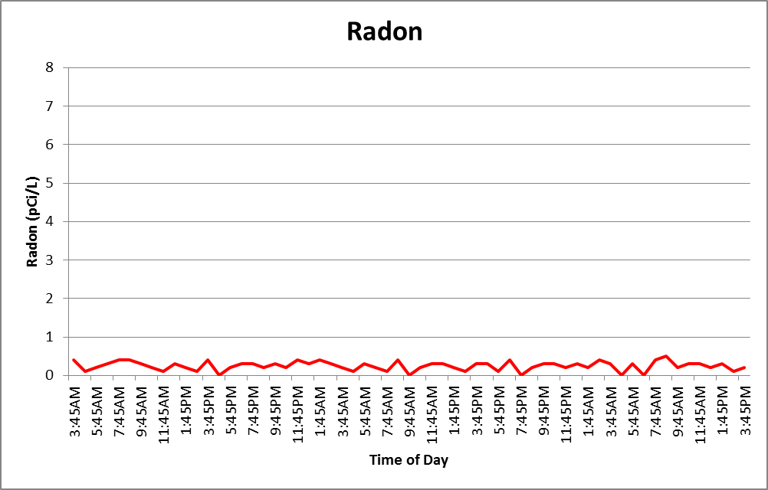
Radon Levels Post-Activation

Slide 71
Code Official’s Perspective

Slide 72
Next Steps w/ Radon Control Adoptions
Check out spreadsheet in CRCPD’s toolkit informing these maps
Please let us know if you learn of additional adoptions the Radon Appendix in the International Residential Code (not the IBC)
http://radonleaders.org/Portal/Toolkits
Resources will be added including this webinar
Notes:
Code officials – what would be helpful? (Josh will check with Don – MN) Statewide building code – how it works + How you get a municipality to adopt something what type of support from state/tribal radon programs helps.

Slide 73
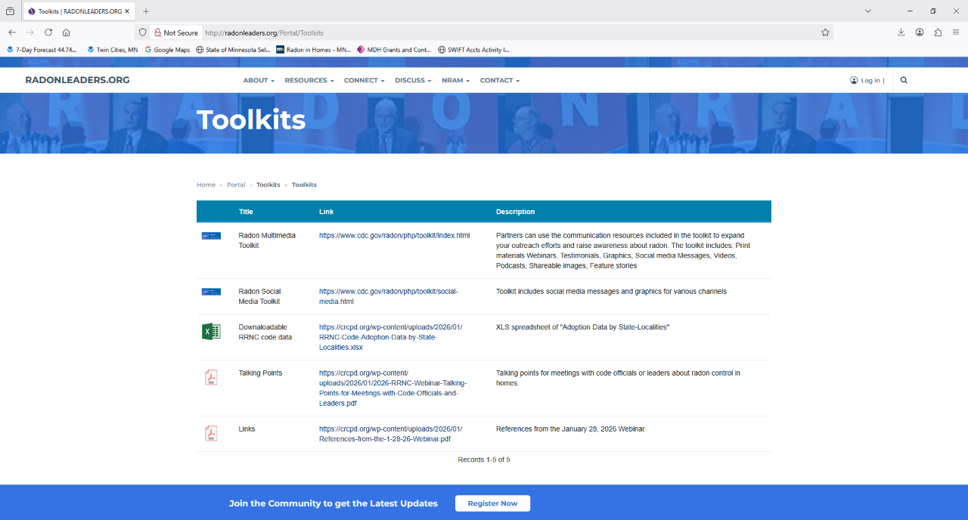

Slide 74
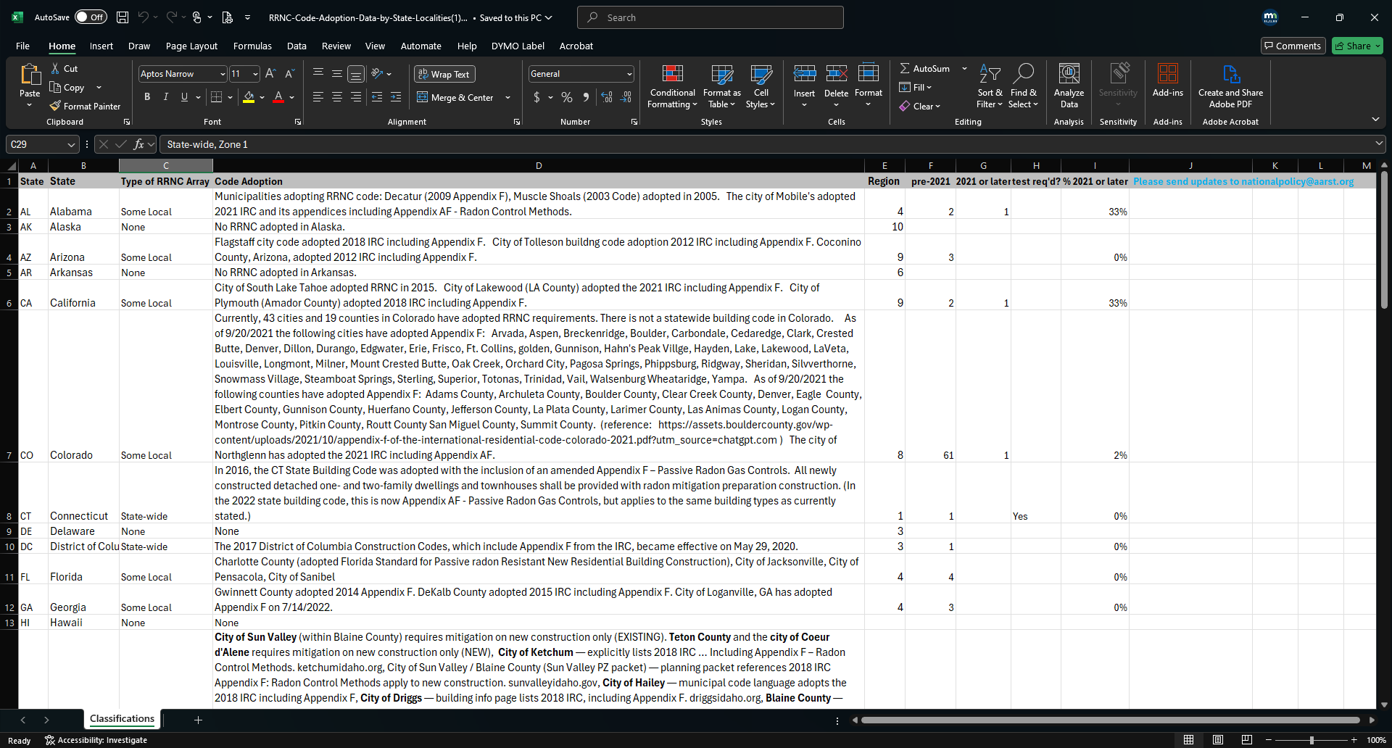

Slide 75


Slide 76


Slide 77
Next Steps w/ Radon Control Adoptions
Make a plan to reach out to code officials in your state
Alert them how to make radon control in new homes more effective:
Adopting the appendix if not already adopted
Requiring post-construction radon tests below 4 pCi/L
Stepping away from the Zone I-only approach
Allowing RRNC as the alternative pathway
Using the checklist in RRNC to inspect systems during construction
Let E-25 and IEA know how it goes and ways we can help
Training materials
Vast experience to aid in speaker notes or meeting preparation
Notes:
Code officials – what would be helpful? (Josh will check with Don – MN) Statewide building code – how it works + How you get a municipality to adopt something what type of support from state/tribal radon programs helps.

Slide 78
For More Information
Joshua Kerber, MS
Chair – CRCPD’s E-25 Committee on Radon
Minnesota Department of Health
Research Scientist | Indoor Air Unit
Office: 651-201-5613
joshua.kerber@state.mn.us
mn.gov/radon

