Slide 1
Radiation Training
Module Template
CRCPD, HS/ER-10 Task force for volunteer development

Slide 2
Module Objectives
(3-5 objectives for each 50 minute module)
By the end of this module, the learner will
  (Action Word) (Concept, Skill, Task)
  Example: Apply the concepts of radiation safety to duties at a community reception center for population monitoring.

Slide 3
Instructional Objectives
(2-5 objectives for each Module Objective)
By the end of this section, the learner will
  (Action Word) (Task, Skill, Concept)
  Example: Describe the principle of time, distance, and shielding.
  If the learner is going to describe the principle, then time during class for that to occur must be provided. This could be achieved by having a group exercise related to time, distance, and shielding. The objective would not be satisfied by the learner simply listening to a lecture, they must do an action to show that they achieved the objective

Slide 4
Putting it together
Example: Module (50 minutes), Title: Radiation Safety for the RRVC Volunteer
Module Objectives: By the end of this module, the learner will…
  Apply the concepts of radiation safety to duties at a community reception center for population monitoring.
  Instructional objective: By the end of this section the learner will…
        Demonstrate contamination control by donning and doffing of personal protective equipment

Slide 5
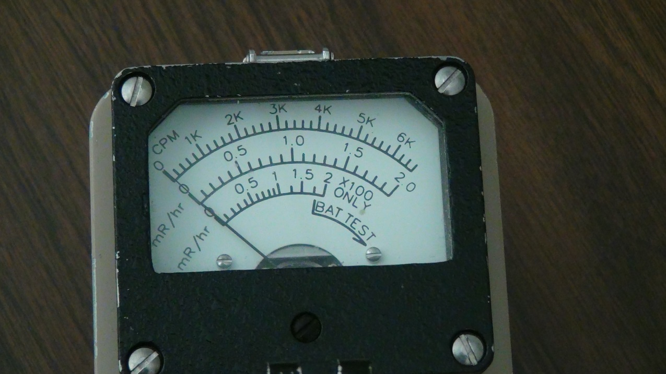
Content Section 1
What is the main point of the section 1 topic?
  Subpoint 1
  Subpoint 2
  Subpoint 3
  Limit text on slide to make it
  easy to follow
Use pictures to help increase interest
Make sure they are relevant

Slide 6
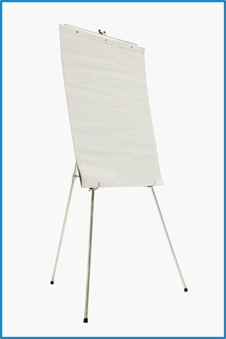

Learning Activity
Include activities
  Learner can apply concepts
  Learner has opportunity to contribute from their own experience
  Builds communication and teamwork among the table groups

Slide 7
Consider Learner Evaluation
Pre and post testing generates data that can be used to determine if the training achieved the objectives.
10 questions is a suitable number for a 50 minute session
  Evaluation design is beyond the scope of this template
  A resource for evaluation value and design can be found at
  https://www.k-state.edu/ksde/alp/resources/Handout-Module6.pdf

Slide 8
Conclusion
Summarize the module objectives
Include a list of resources that can be given to the learners to enhance areas that were only covered minimally in the module
Include contact information for follow-up

Slide 9
Feedback
Collect feedback from the learner such as
  The training provided me with new information.
    1= strongly disagree to 5 = strongly agree
  The training aids, visuals, and handouts were useful.
    1= strongly disagree to 5 = strongly agree
  What did you like best about this training?
  What were some things you would like to see changed?

